Slide 1

CMR Technical Campus Department of CSE
Industrial Oriented Mini Project
Project Title: A novel hybrid deep learning methods for early detection of lung cancer using neural networks
Project Supervisor:​
Name:​ Mr. A. Ganapathi
Designation: Assisstant Professer
Presented By:​
Batch No: 11
H. No: 227R1A0599 Name: Akshitha Rao
H. No: 227R1A05A1 Name: M.Ganesh​
H. No: 227R1A0580 Name: D.Anudeep​

Slide 2
Index:
Introduction and overview of project (Abstract)​
Existing System
Disadvantages
Proposed System
Advantages
Hardware and Software Requriments
Novelty of project
Architecture
Modules
UML Diagram
Sample Code
Results
Conclusion
Future Scop
References

Slide 3
Department Vision anD Mission:
DEPARTMENT VISION:
To provide quality education and a conducive learning environment in computer engineering that foster critical thinking, creativity, and practical problem-solving skills.
DEPARTMENT MISSION:
To educate the students in fundamental principles of computing and induce the skills needed to solve practical problems.
2. To provide State-of-the-art computing laboratory facilities to promote industry institute interaction to enhance student’s practical knowledge.
3. To inculcate self-learning abilities, team spirit, and professional ethics among the students to serve society.

Slide 4
Introduction:
Lung cancer is a leading cause of death, and early detection is vital for survival.
Traditional methods, like CT scans, are slow and error-prone.
Proposed approach: Cancer Cell Detection using Hybrid Neural Network (CCDC-HNN).
Combines 3D-Convolutional Neural Networks (3D-CNN) for feature extraction and Long Short-Term Memory (LSTM) networks to analyze temporal changes.
Utilizes UNET algorithm for cancer cell segmentation.
Classifies cells as benign or malignant.
Aims to improve accuracy, speed, and early detection of lung cancer.
Potential to assist healthcare professionals in providing timely treatment.

Slide 5
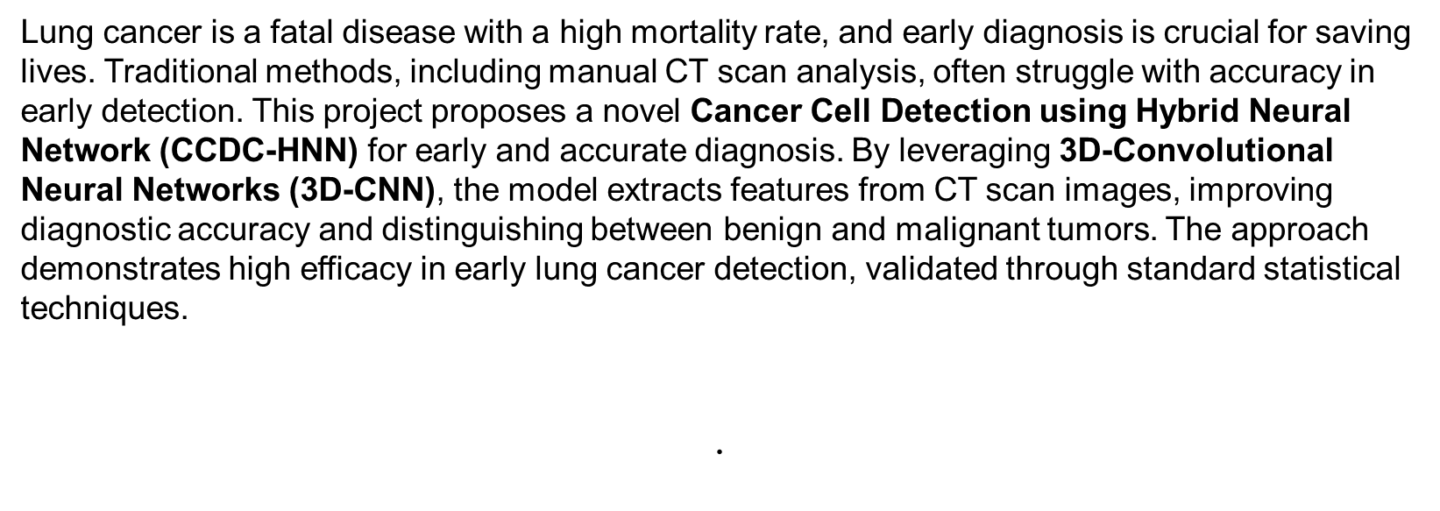
Abstract​:

Slide 6
EXISTING SYSTEM:​
The aberrant proliferation of malignant cells in the lungs is the defining characteristic of lung cancer, a deadly hereditary illness. Lung cancer may have devastating effects since the lungs are such an important part of the human body. In this study, we have concentrated on the rapid diagnosis of lung cancer for the benefit of both patients and physicians. Histopathology scans, together with other diagnostic methods, can be used to identify lung cancer.
Disadvantage:
Less Accuracy
Time taking

Slide 7
PROPOSED SYSTEM
Using lung histopathology pictures, the proposed study employs a hybridised model of Convolution neural networks with an ensemble of Machine Learning algorithms, including Support Vector Classifier, Random Forest, and XG Boost. In all, this job has a 99.13% success rate.
Advantage
Less time taking

Slide 8
Requirement Analysis:​
HARDWARE REQUIREMENTS:
Processor : intel i3(min)
Hard Disk : 40 GB.
RAM : 4 GB.
SOFTWARE REQUIREMENTS:
Operating System : Windows 10/above
Programming Language : Python 3.7.0

Slide 9
NOVELTY OF PROJECT
🔀 Hybrid Model Approach
Combines deep learning (CNN) and machine learning algorithms (SVC, Random Forest, XGBoost).
Most existing projects use only one type — this combination improves accuracy and reliability.
🧠 Smart Two-Step Diagnosis
Step 1: Detects lung cancer risk level (HIGH, MEDIUM, LOW) from health data.
Step 2: If the risk is HIGH, then it checks CT scan images using another model.
This smart process saves time, cost, and computing power.
💡 Ensemble Voting Technique
Uses three different algorithms together to make final decisions (voting method).
This reduces the chance of errors and gives better performance than using just one algorithm.
📈 Very High Accuracy
The ensemble model achieves 99.13% accuracy.
That’s higher than many other similar systems in the literature.
🖥️ User-Friendly Python GUI
Includes a graphical interface to upload data, train models, and see results easily.
Makes the system practical for doctors and users — not just for researchers.
🧪 Uses Real CT-Scan Images
The model also works with actual CT-scan images to detect if lungs are normal or abnormal.
Adds real-world value — many systems only work on datasets, not images.
📂 Modular Design
Clear step-by-step system: Upload → Preprocess → Train → Predict.
Makes it easy to understand, modify, or improve in the future.
🎯 Efficient Resource Usage
Only processes CT images if needed (when cancer risk is high).
Helps avoid unnecessary scans, saving money and reducing hospital load.

Slide 10
Input and processing
Segmentation using U-Net
Feature Extraction using CNN
Data-Preprocessing
(Image Resizing, Normalization, Noise Reduction, Data Agumentation)
Classification using Hybrid Models(MLP, decision tree, adaboost)
Final classification
Performance evaluation
Design/Architecture:​

Slide 11
MODULES
Upload Lung Cancer Dataset: using this module we will Upload Lung Cancer Dataset
Dataset Preprocessing: using this module we will Dataset Preprocessing
Run Ensemble Algorithm: using this module we will Run Ensemble Algorithm
Predict Lung Cancer Disease: using this module we will Predict Lung Cancer Disease
Train RBF on LUNGS CT-SCAN Image: using this module we will Train RBF on LUNGS CT-SCAN Image
Predict Cancer from CT-Scan: using this module we will Predict Cancer from CT-Scan

Slide 12
UML DIAGRAM
The Unified Modelling Language allows the software engineer to express an analysis model using the modelling notation that is governed by a set of syntactic semantic and pragmatic rules.
User Model View
This view represents the system from the users perspective.
The analysis representation describes a usage scenario from the end-users perspective.
Structural Model view
In this model the data and functionality are arrived from inside the system.
This model view models the static structures.

Slide 13
.
Behavioural Model View
It represents the dynamic of behavioural as parts of the system, depicting the interactions of collection between various structural elements described in the user model and structural model view.
Implementation Model View
In this the structural and behavioural as parts of the system are represented as they are to be built.
Environmental Model View
In this the structural and behavioural aspects of the environment in which the system is to be implemented are represented.

Slide 14
USE CASE DIAGRAM
Use Case Diagram
A use case diagram shows:
Who uses the system (called users or actors),
What the users can do in the system (called use cases).
It’s like a map of user actions — showing how
different people interact with the system in different ways.

Slide 15
CLASS DIAGRAM
A class diagram shows the main parts of a program in an organized way.
It includes:
Classes (like blueprints for objects),
What each class has (its attributes, like data),
What each class does (its methods, or actions).

Slide 16
SEQUENCE DIAGRAM
A sequence diagram shows how different parts of a system talk to each other step-by-step to complete a task.
What it shows:
Who is involved (like users or system parts),
What messages they send to each other,
The order in which the messages are sent (from top to bottom = time order).
Think of it like:
A chat conversation between parts of a system — showing who says what and when.

Slide 17
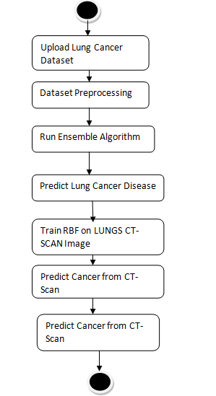
ACTIVITY DIAGRAM
Activity Diagram
An activity diagram is like a flowchart. It shows the step-by-step flow of activities in a system.
It shows what happens first, next, or at the same time.
The flow can be straight, branched, or parallel.

Slide 18
SAMPLE CODE
import pandas as pd
from sklearn.model_selection import train_test_split
from sklearn.preprocessing import LabelEncoder, normalize
from sklearn.ensemble import VotingClassifier, AdaBoostClassifier
from sklearn.neural_network import MLPClassifier
from sklearn.tree import DecisionTreeClassifier
from sklearn.metrics import accuracy_score
df = pd.read_csv('dataset.csv').fillna(0)
df['Level'] = LabelEncoder().fit_transform(df['Level'])
df['Patient Id'] = LabelEncoder().fit_transform(df['Patient Id'])
X = normalize(df.iloc[:, 1:-1])
y = df.iloc[:, -1].astype(int)
X_train, X_test, y_train, y_test = train_test_split(X, y, test_size=0.2, random_state=0)
model = VotingClassifier(estimators=[
('dt', DecisionTreeClassifier()),
('ada', AdaBoostClassifier(n_estimators=100)),
('mlp', MLPClassifier(max_iter=200, hidden_layer_sizes=100))
], voting='soft').fit(X_train, y_train)
preds = model.predict(X_test)
print("Accuracy:", accuracy_score(y_test, preds) * 100)

Slide 19
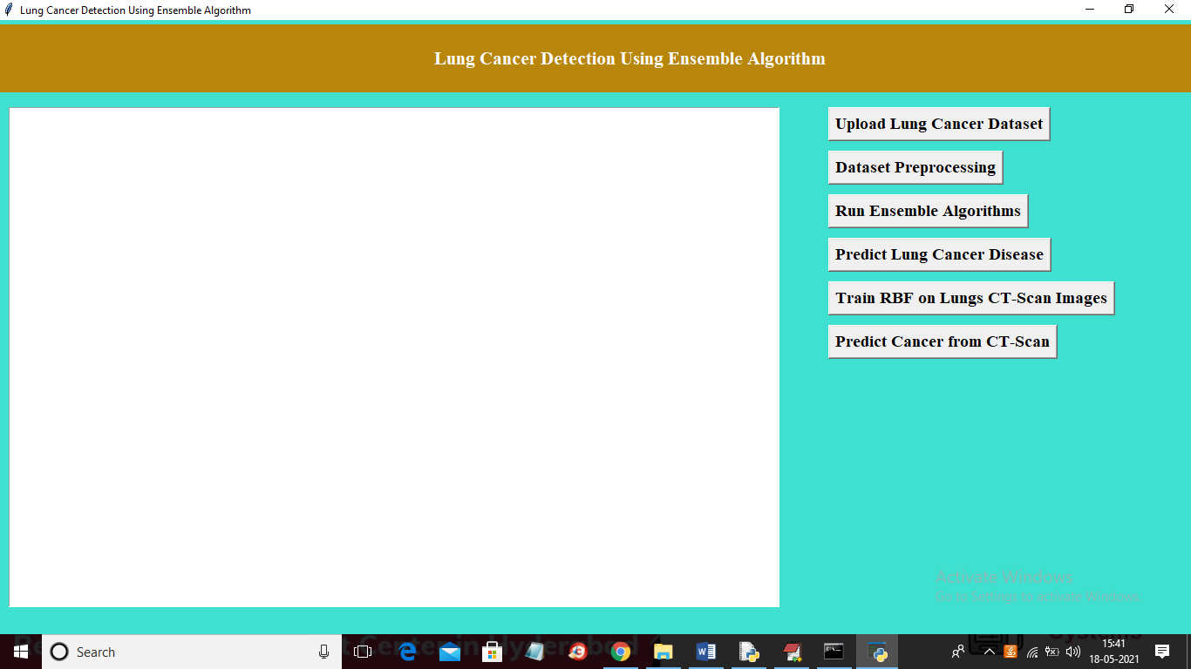
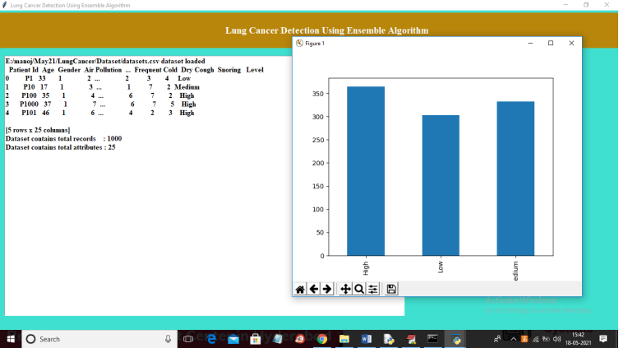
RESULTS
In above screen click on ‘Upload Lung Cancer Dataset’ button to upload dataset
In above screen in text area we can see dataset loaded and dataset contains total 1000 records and 25 columns and in above dataset we can see some string values are there but machine learning algorithms accept only numeric values so we need to preprocess above dataset to convert string

Slide 20
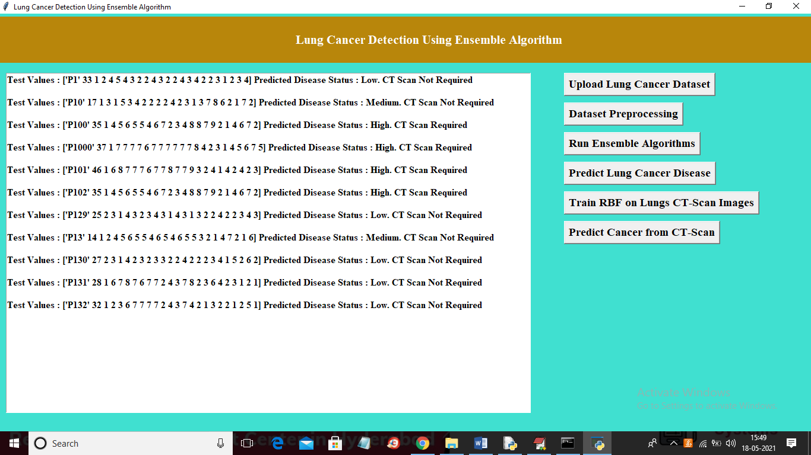
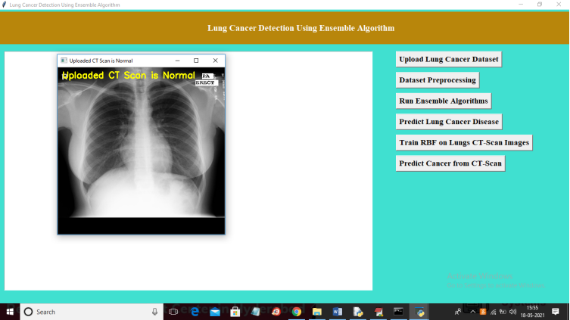
RESULTS
In above screen in square bracket we can see test values and then by analysing those test values ensemble has given prediction result as LOW, HIGH or MEDIUM and we can see this result after square bracket and if disease high then application asking user to go for CT-SCAN image. Now click on ‘Train RBF on LUNGS CT-SCAN Image’ to train RBF with lungs CT-SCAN.
In above screen predicted result is ‘NORMAL’ and similarly you can upload remaining images and test

Slide 21
CONCLUSION
In this project we are using Lung Cancer dataset to train ensemble algorithm by combining AdaBoost, Multilayer Perceptron and Decision Tree and then after training when we upload test data then this algorithm will predict lung cancer stage as HIGH, LOW and MEDIUM and if HIGH detected then application will ask user to go for CT-SCAN.Here we designed another algorithm using RBF and lung cancer CT-SCAN images and this CT-SCAN images will be trained using RBF algorithm and then after training when user upload test image then application will predict whether uploaded CT-SCAN is normal or abnormal.

Slide 22
FUTURE SCOPE
1. Improved diagnosis accuracy
2. Early detection and personalized medicine
3. Multi-modal fusion and explainability
4. Real-time processing and edge AI deployment
Potential impact:
1. Improved patient outcomes
2. Reduced healthcare costs
3. Advancements in cancer research

Slide 23
References:​
>LIDC-IDRI Dataset: Armato III, S. G., McLennan, G., Bidaut, L., McNitt-Gray, M. F., Meyer, C. R., Reeves, A. P., ... & Clarke, L. P. (2011). The Lung Image Database Consortium (LIDC) and Image Database Resource Initiative (IDRI): A completed reference database of lung nodules on CT scans. Medical Physics, 38(2), 915-931.
Deep Learning Techniques: LeCun, Y., Bengio, Y., & Hinton, G. (2015). Deep learning. Nature, 521(7553), 436-444.
UNET Segmentation: Ronneberger, O., Fischer, P., & Brox, T. (2015). U-Net: Convolutional networks for biomedical image segmentation. International Conference on Medical Image Computing and Computer-Assisted Intervention, 234-241

Slide 24
THANK YOU

